Slide 1
Organizational Design

Slide 2
Learning Outcomes
Students will recognize & understand organizational design.

Slide 3
Organizational Design
Organizational design is as much an art as it is a science. The process of creating a system in which people can work together to achieve common goals is highly complex and there is no one way to do it right.
Organizational design involves implementing organizational structures and systems that align to an organization's core strategies. Often organization redesign happens because a business is growing or needs to downsize.

Slide 4
Organization Design is often divided into two distinct styles:
Hierarchical. 2. Organic.
Hierarchical Organization Designs
Hierarchical organizational designs often fall into two main categories:
Functional
Divisional

Slide 5
Functional structures.
Functions – such as accounting, marketing, HR and so on – are separate, each led by a senior executive who reports to the CEO.
This can be a very efficient structure, allowing for economies of scale because specialists work for the whole organization.
However, there needs to be clear lines of communication and accountability. There's also a danger that functional goals end up overshading the overall aims of the organization, and there's often little scope for cross-team collaboration.

Slide 6
Divisional structures.
The company is organized by office or customer location.
Each division is autonomous and has a manager who reports to the CEO.
A key advantage of this type of structure is that each division is free to concentrate on its own performance, and its people can build up strong local links.
However, this can also lead to duplication of duties. People may also feel disconnected from the company as a whole, and enjoy fewer opportunities to gain training in different areas of the business.

Slide 7
2. Organic Organization Designs
Organic organizational designs include:
Simple/Flat structure:
This type of structure is common among small businesses.
There may only be one or two management levels, with people working together as one, large team, and reporting to the same, single person.
This can be a very efficient way of working, as responsibilities are clear, and there's a useful level of flexibility.
However, it can also hold back progress if the company grows to a point where the founder or CEO no longer has enough time to make all the decisions.

Slide 8
Matrix structure.
Here, people typically have two or more lines of report.
This type of organization may combine both functional and divisional lines of responsibility, allowing it to focus on divisional performance, while also sharing specialized skills and resources.
However, matrix structures can become overly complex, effectively having to uphold two different hierarchies, which may start to compete. This may even create tension and result in conflict, in some cases.

Slide 9
Network structures.
Often known as a "lean" structure, this type of organization has central, core functions that operate the strategic business, and outsources or subcontracts non-core functions.
This structure is very flexible, and it can adapt to new market challenges almost immediately.
However, there's an unavoidable loss of control due to its dependence on third parties, and all the potential problems that result from managing outsourced or subcontracted teams.

Slide 10
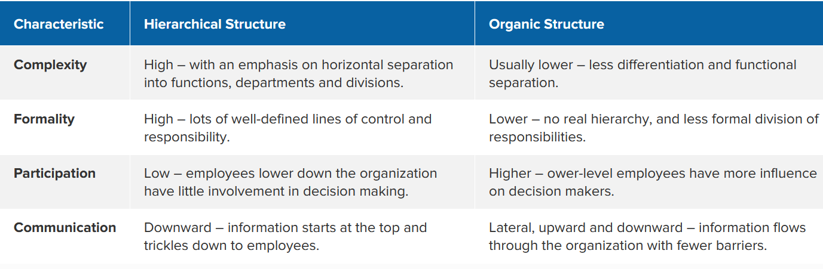
L

Slide 11
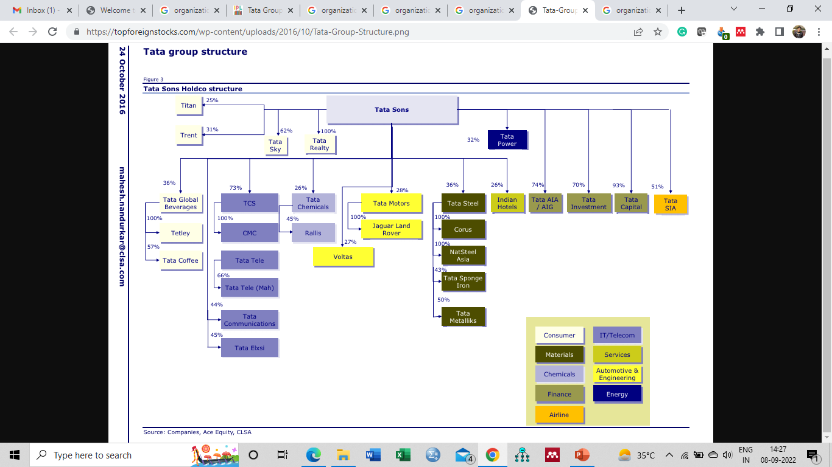

Slide 12
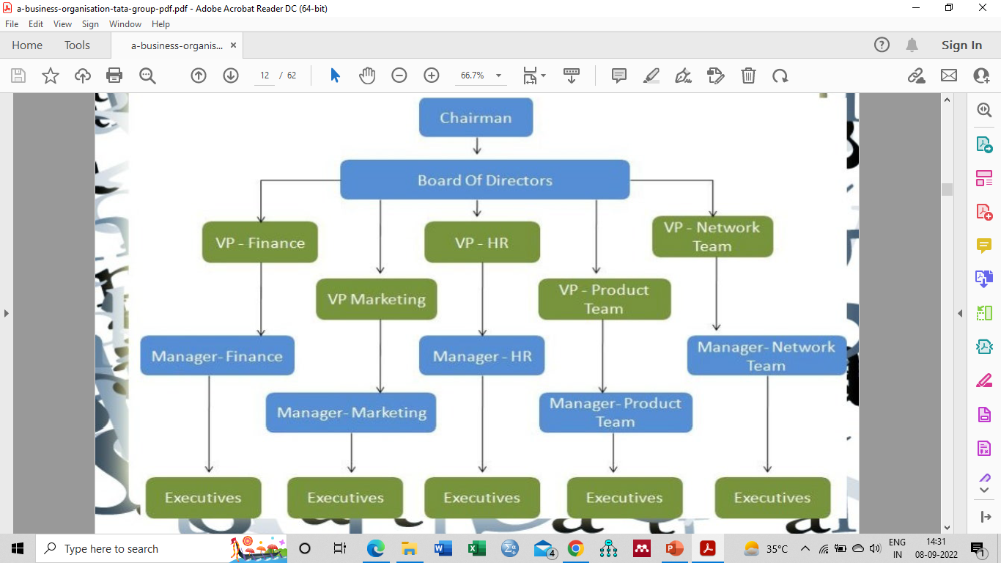

Slide 13
Thank You

